Slide 1


Introduction to Boosting Algorithms
Boosting is a powerful machine learning technique that combines multiple weak models to create a strong, highly accurate predictive model. In this comprehensive guide, we will dive into the fundamentals of boosting, explore popular boosting algorithms like AdaBoost and Gradient Boosting, and learn how to implement and optimize boosting in practice. Boosting algorithms work by iteratively training weak learners, such as decision trees, and then combining them to create a robust, high-performing model. This approach has proven to be highly effective in a wide range of applications, from classification and regression to ranking and anomaly detection.
by Praveen kumar T G

Slide 2
Fundamentals of Boosting
Weak Learners
Iterative Training
Ensemble Learning
Boosting algorithms start with a set of weak learners, which are models that perform slightly better than random guessing. These weak learners are then combined in an iterative fashion to create a strong, highly accurate model.
The key to boosting is its iterative training process. In each iteration, a new weak learner is trained on the data, with a focus on the examples that were misclassified by the previous weak learners. This allows the boosting algorithm to gradually improve the overall performance of the model.
Boosting is a form of ensemble learning, where multiple models are combined to create a more powerful and accurate predictor. By leveraging the strengths of different weak learners, boosting can achieve significantly better performance than any single model alone.

Slide 3
Popular Boosting Algorithms
1
AdaBoost
2
Gradient Boosting
AdaBoost, or Adaptive Boosting, is one of the earliest and most widely used boosting algorithms. It works by iteratively training weak learners and adjusting the weights of the training examples to focus on the ones that were previously misclassified.
Gradient Boosting is a more recent and powerful boosting algorithm that uses gradient descent to minimize a loss function. It can be used with a variety of weak learners, including decision trees, and is highly effective for both classification and regression tasks.
3
XGBoost
4
LightGBM
XGBoost, or Extreme Gradient Boosting, is a highly optimized and efficient implementation of Gradient Boosting that has become a go-to choice for many data scientists and machine learning practitioners.
LightGBM is another popular Gradient Boosting algorithm that uses tree-based learning algorithms. It is known for its speed, efficiency, and ability to handle large-scale data and high-dimensional features.

Slide 4
Implementing Boosting in Practice
Data Preprocessing
Model Training and Evaluation
Before applying a boosting algorithm, it's important to ensure that your data is properly preprocessed and ready for training. This includes handling missing values, encoding categorical variables, and scaling numerical features.
Once you've selected the appropriate boosting algorithm, you can proceed to train the model on your data. Be sure to monitor the model's performance on both the training and validation sets to ensure that it is generalizing well and not overfitting.
1
2
3
Model Selection
Choosing the right boosting algorithm and its hyperparameters is crucial for achieving optimal performance. You may need to experiment with different algorithms and tune the hyperparameters using techniques like cross-validation or grid search.

Slide 5
Optimizing Boosting for Performance and Accuracy
Feature Engineering
Regularization
Boosting algorithms can benefit greatly from well-crafted features. Spend time exploring your data and engineering new features that capture relevant patterns and relationships.
Boosting models can be prone to overfitting, so it's important to use regularization techniques like early stopping, L1/L2 regularization, or setting a maximum depth for the weak learners.
Parallelization
Ensemble Techniques
Many boosting algorithms, such as XGBoost and LightGBM, can be parallelized to take advantage of multi-core processors and accelerate the training process.
Combining multiple boosting models, either through stacking or blending, can often lead to further performance improvements and increased robustness.

Slide 6
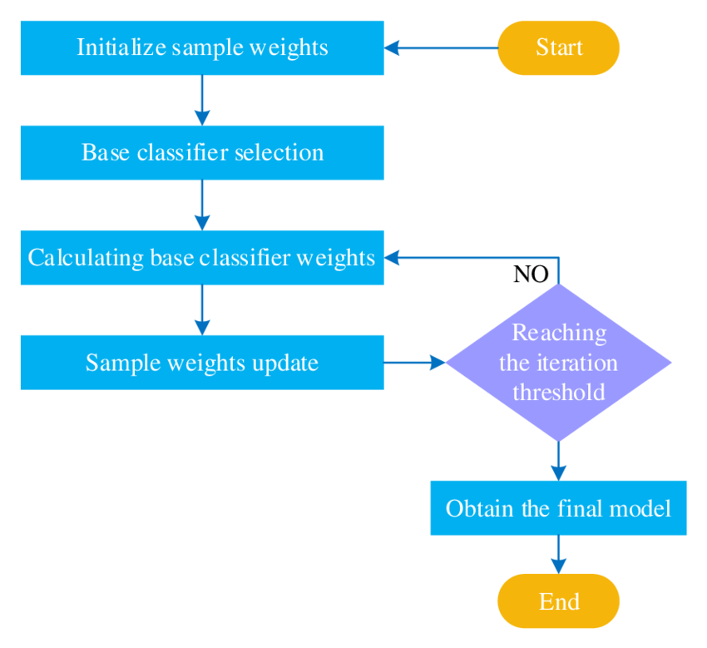



AdaBoost
Weak Learners
AdaBoost starts with a set of weak learners, such as decision stumps or shallow decision trees.
Iterative Training
In each iteration, AdaBoost trains a new weak learner and adjusts the weights of the training examples to focus on the ones that were previously misclassified.
Ensemble Prediction
The final prediction is made by combining the predictions of all the weak learners, with each learner weighted by its importance in the ensemble.

Slide 7




XGBoost
Efficiency
Scalability
Flexibility
Performance
XGBoost is known for its highly optimized and efficient implementation of Gradient Boosting, making it a popular choice for large-scale data and high-dimensional problems.
XGBoost can handle large datasets and high-dimensional features, thanks to its efficient use of system resources and its ability to parallelize the training process.
XGBoost supports a wide range of objective functions, making it applicable to a variety of machine learning tasks, including classification, regression, and ranking.
XGBoost has consistently demonstrated state-of-the-art performance on a wide range of benchmarks and real-world applications, making it a go-to choice for many data scientists.

Slide 8
LightGBM
Efficiency
LightGBM is highly efficient, thanks to its use of gradient-based one-sided sampling and exclusive feature bundling, which can significantly speed up the training process.
Handling Large-Scale Data
LightGBM is designed to work with large-scale data and high-dimensional features, making it a suitable choice for a wide range of machine learning problems.
Accuracy
Despite its efficiency, LightGBM maintains a high level of accuracy, often outperforming other boosting algorithms on a variety of tasks.
Ease of Use
LightGBM has a user-friendly API and requires fewer hyperparameters to tune, making it relatively straightforward to implement and use.

Slide 9



Gradient Boosting
Powerful Performance
Versatile Applicability
Interpretable Models
Gradient boosting is a highly effective ensemble method that can significantly improve the accuracy of your predictive models.
It can be applied to a wide range of problem domains, from regression to classification and beyond.
The decision trees used in gradient boosting provide a level of interpretability that is often lacking in other complex models.
Gradient boosting is a powerful and versatile machine learning technique that can help you unlock the full potential of your data. By understanding its mechanics, advantages, and limitations, you can effectively leverage gradient boosting to tackle a wide range of real-world challenges.

Slide 10
Thank You

